Slide 1
Data Mining: Data
Lecture Notes for Chapter 2
Introduction to Data Mining
by
Tan, Steinbach, Kumar

Slide 2
What is Data?
Collection of data objects and their attributes
An attribute is a property or characteristic of an object
Examples: eye color of a person, temperature, etc.
Attribute is also known as variable, field, characteristic, or feature
A collection of attributes describe an object
Object is also known as record, point, case, sample, entity, or instance
Attributes
Objects

Slide 3
Attribute Values
Attribute values are numbers or symbols assigned to an attribute
Distinction between attributes and attribute values
Same attribute can be mapped to different attribute values
Example: height can be measured in feet or meters
Different attributes can be mapped to the same set of values
Example: Attribute values for ID and age are integers
But properties of attribute values can be different
ID has no limit but age has a maximum and minimum value

Slide 4
Measurement of Length
Same attribute can be mapped to different attribute values. Example: height can be measured in feet or meters.
The way you measure an attribute is somewhat may not match the attributes properties.
Different attributes can be mapped to the same set of values. Example: Attribute values for ID and age are integers. But properties of attribute values can be different, has a maximum and minimum value.

Slide 5
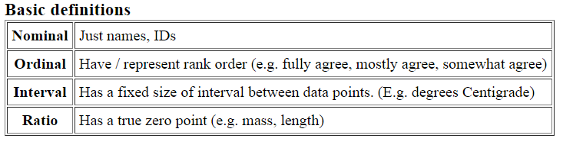
Types of Attributes

Slide 6
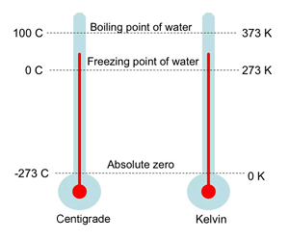
Types of Attributes
There are different types of attributes
Nominal
Examples: ID numbers, eye color, zip codes
Ordinal
Examples: rankings (e.g., taste of potato chips on a scale from 1-10), grades, height in {tall, medium, short}
Interval
Examples: calendar dates, temperatures in Celsius or Fahrenheit.
Ratio
Examples: temperature in Kelvin, length, time, counts
Have absolute zero

Slide 7
Properties of Attribute Values
The type of an attribute depends on which of the following properties it possesses:
Distinctness: = ≠
Order: < >
Addition: + -
Multiplication: * /
Nominal attribute: distinctness
Ordinal attribute: distinctness & order
Interval attribute: distinctness, order & addition
Ratio attribute: all 4 properties

Slide 8
Attribute Type
Description
Examples
Operations
Nominal
The values of a nominal attribute are just different names, i.e., nominal attributes provide only enough information to distinguish one object from another. (=, ≠)
zip codes, employee ID numbers, eye color, sex: {male, female}
mode, entropy, contingency correlation, χ² test
Ordinal
The values of an ordinal attribute provide enough information to order objects. (<, >)
hardness of minerals, {good, better, best}, grades, street numbers
median, percentiles, rank correlation, run tests, sign tests
Interval
For interval attributes, the differences between values are meaningful, i.e., a unit of measurement exists. (+, - )
calendar dates, temperature in Celsius or Fahrenheit
mean, standard deviation, Pearson's correlation, t and F tests
Ratio
For ratio variables, both differences and ratios are meaningful. (*, /)
temperature in Kelvin, monetary quantities, counts, age, mass, length, electrical current
geometric mean, harmonic mean, percent variation

Slide 9
Attribute Level
Transformation
Comments
Nominal
Any permutation of values
If all employee ID numbers were reassigned, would it make any difference?
Ordinal
An order preserving change of values, i.e., new_value = f(old_value) where f is a monotonic function.
An attribute encompassing the notion of good, better best can be represented equally well by the values {1, 2, 3} or by { 0.5, 1, 10}.
Interval
new_value =a * old_value + b where a and b are constants
Thus, the Fahrenheit and Celsius temperature scales differ in terms of where their zero value is and the size of a unit (degree).
Ratio
new_value = a * old_value
Length can be measured in meters or feet.

Slide 10
Level of Measurement Decision Tree
Ordered?
Yes.
Equally Spaced?
No.
Nominal
Yes.
Zero means none?
No.
Ordinal
Yes.
Ratio
No.
Interval

Slide 11
Discrete and Continuous Attributes
Discrete Attribute
Has only a finite or countably infinite set of values
Examples: zip codes, counts, or the set of words in a collection of documents
Often represented as integer variables.
Note: binary attributes are a special case of discrete attributes
Continuous Attribute
Has real numbers as attribute values
Examples: temperature, height, or weight.
Practically, real values can only be measured and represented using a finite number of digits.
Continuous attributes are typically represented as floating-point variables.

Slide 12
Types of data sets
Record
Data Matrix
Document Data
Transaction Data
Graph
World Wide Web
Molecular Structures
Ordered (discussed in next slides)
Spatial Data or geospatial data
Temporal Data: data changes with the time.
NASA has deployed a series of Earth orbiting satellites that continuously generate global observations of the Land surface, oceans, and atmosphere.
Sequential Data
Genetic Sequence Data

Slide 13
Important Characteristics of Structured Data
Dimensionality
Curse of Dimensionality, refers to various phenomena that arise when analyzing and organizing data in high-dimensional spaces (often with hundreds or thousands of dimensions) that do not occur in low-dimensional settings such as the three-dimensional physical space of everyday experience.
Sparsity: Only presence counts
The common theme of these problems is that when the dimensionality increases, the volume of the space increases so fast that the available data become sparse. This sparsity is problematic for any method that requires statistical significance. In order to obtain a statistically sound and reliable result, the amount of data needed to support the result often grows exponentially with the dimensionality. Also, organizing and searching data often relies on detecting areas where objects form groups with similar properties; in high dimensional data, however, all objects appear to be sparse and dissimilar in many ways, which prevents common data organization strategies from being efficient.
Resolution
Patterns depend on the scale

Slide 14
Record Data
Data that consists of a collection of records, each of which consists of a fixed set of attributes

Slide 15
Data Matrix
If data objects have the same fixed set of numeric attributes, then the data objects can be thought of as points in a multi-dimensional space, where each dimension represents a distinct attribute
Such data set can be represented by an m by n matrix, where there are m rows, one for each object, and n columns, one for each attribute

Slide 16
Document Data
Each document becomes a `term' vector,
each term is a component (attribute) of the vector,
the value of each component is the number of times the corresponding term occurs in the document.

Slide 17
Transaction Data
A special type of record data, where
each record (transaction) involves a set of items.
For example, consider a grocery store. The set of products purchased by a customer during one shopping trip constitute a transaction, while the individual products that were purchased are the items.

Slide 18
Graph Data
Examples: Generic graph and HTML Links

Slide 19
Chemical Data
Benzene Molecule: C₆H₆

Slide 20
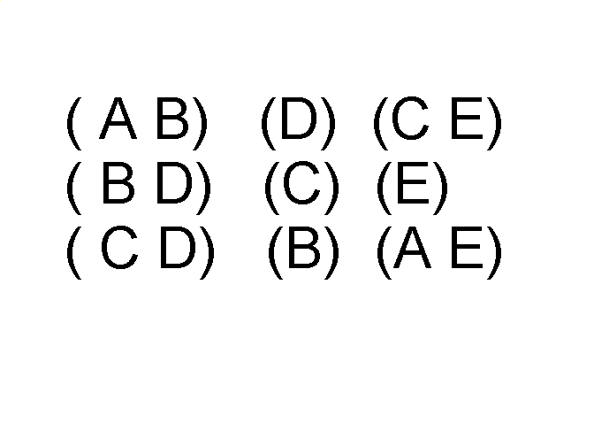
Ordered Data
Sequences of transactions
Items/Events
An element of the sequence

Slide 21
Ordered Data
Genomic sequence data

Slide 22
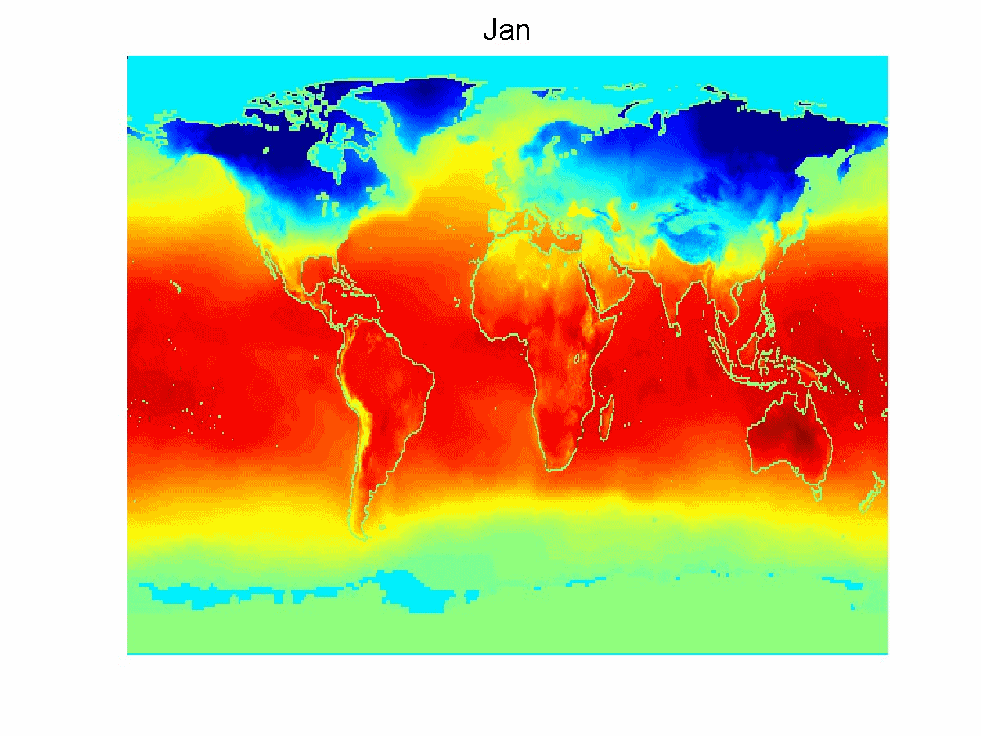
Ordered Data
Spatio-Temporal Data
Average Monthly Temperature of land and ocean

Slide 23
Data Quality
What kinds of data quality problems?
How can we detect problems with the data?
What can we do about these problems?
Examples of data quality problems:
Noise and outliers
missing values
duplicate data

Slide 24
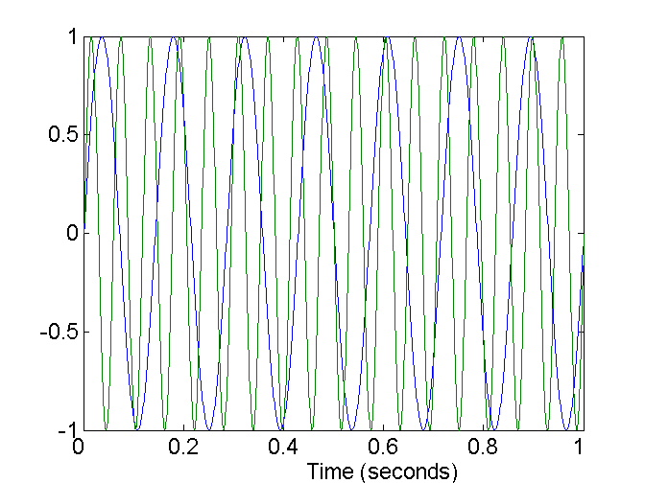
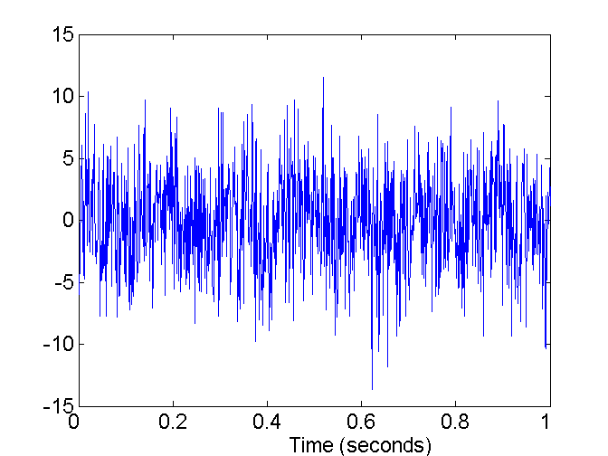
Noise
Noise refers to modification of original values
Examples: distortion of a person’s voice when talking on a poor phone and “snow” on television screen
Two Sine Waves
Two Sine Waves + Noise

Slide 25

Outliers
Outliers are data objects with characteristics that are considerably different than most of the other data objects in the data set

Slide 26
Missing Values
Reasons for missing values
Information is not collected (e.g., people decline to give their age and weight)
Attributes may not be applicable to all cases (e.g., annual income is not applicable to children)
Handling missing values
Eliminate Data Objects or attribute
if many objects have missing values, then a reliable analysis can be difficult or impossible.
Estimate Missing Values (examples on next slide)
Ignore the Missing Value During Analysis
For example, suppose that objects are being clustered and the similarity between pairs of data objects needs to be calculated.
many classification schemes can be modified to work with missing values.
Replace with all possible values (weighted by their probabilities)

Slide 27
Estimate Missing Values
Sometimes missing data can be reliably estimated.
For example, consider a time series that changes in a reasonably smooth fashion, but has a few, widely scattered missing values. In such cases, the missing values can be estimated (interpolated) by using the remaining values.
As another example, consider a data set that has many similar data points. In this situation, the attribute values of the points closest to the point with the missing value are often used to estimate the missing value.
If the attribute is continuous, then the average attribute value of the nearest neighbors is used;
if the attribute is categorical, then the most commonly occurring attribute value can be taken.
For a concrete illustration, consider precipitation measurements that are recorded by ground stations. For areas not containing a ground station, the precipitation can be estimated using values observed at nearby ground stations

Slide 28
Inconsistent Values
Data inconsistency is a condition that occurs between files when similar data is kept in different formats in two different files, or when matching of data must be done between files.
Consider an address field, where both a zip code and city are listed, but the specified zip code area is not contained in that city.
It may be that the individual entering this information transposed two digits, or perhaps a digit was misread when the information was scanned
Some types of inconsistences are easy to detect. For instance, a person's height should not be negative
It can be corrected like by “check digit” methods. Like product code, bank cheque numbers contain check digits.

Slide 29
Duplicate Data
Data set may include data objects that are duplicates, or almost duplicates of one another
Major issue when merging data from heterogeous sources
Two issue in duplication
First: Two objects represent one objects actually (same person data)
Example: Same person with multiple email addresses
Second: Two objects are very similar but represent two objects (not representing same persons data)
Care needs to be taken to avoid accidentally combining data objects that are similar, but not duplicates, such as two distinct people with identical names. The term deduplication is often used to refer to the process of dealing with these issues.
Data cleaning
Process of dealing with duplicate data issues

Slide 30
Data Preprocessing

Slide 31
Data Preprocessing
Aggregation
Sampling
Dimensionality Reduction
Feature subset selection
Feature creation
Discretization and Binarization
Attribute Transformation

Slide 32
Aggregation
Combining two or more attributes (or objects) into a single attribute (or object)
Purpose
Data reduction
Reduce the number of attributes or objects
Change of scale
Cities aggregated into regions, states, countries, etc
More “stable” data
Aggregated data tends to have less variability

Slide 33
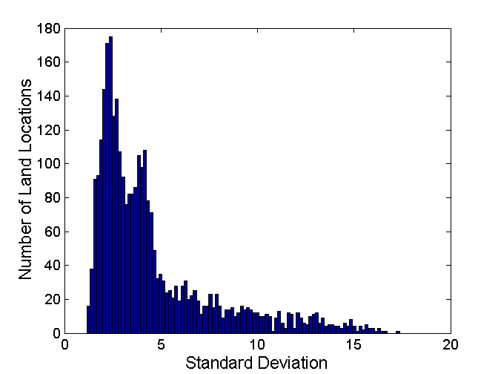
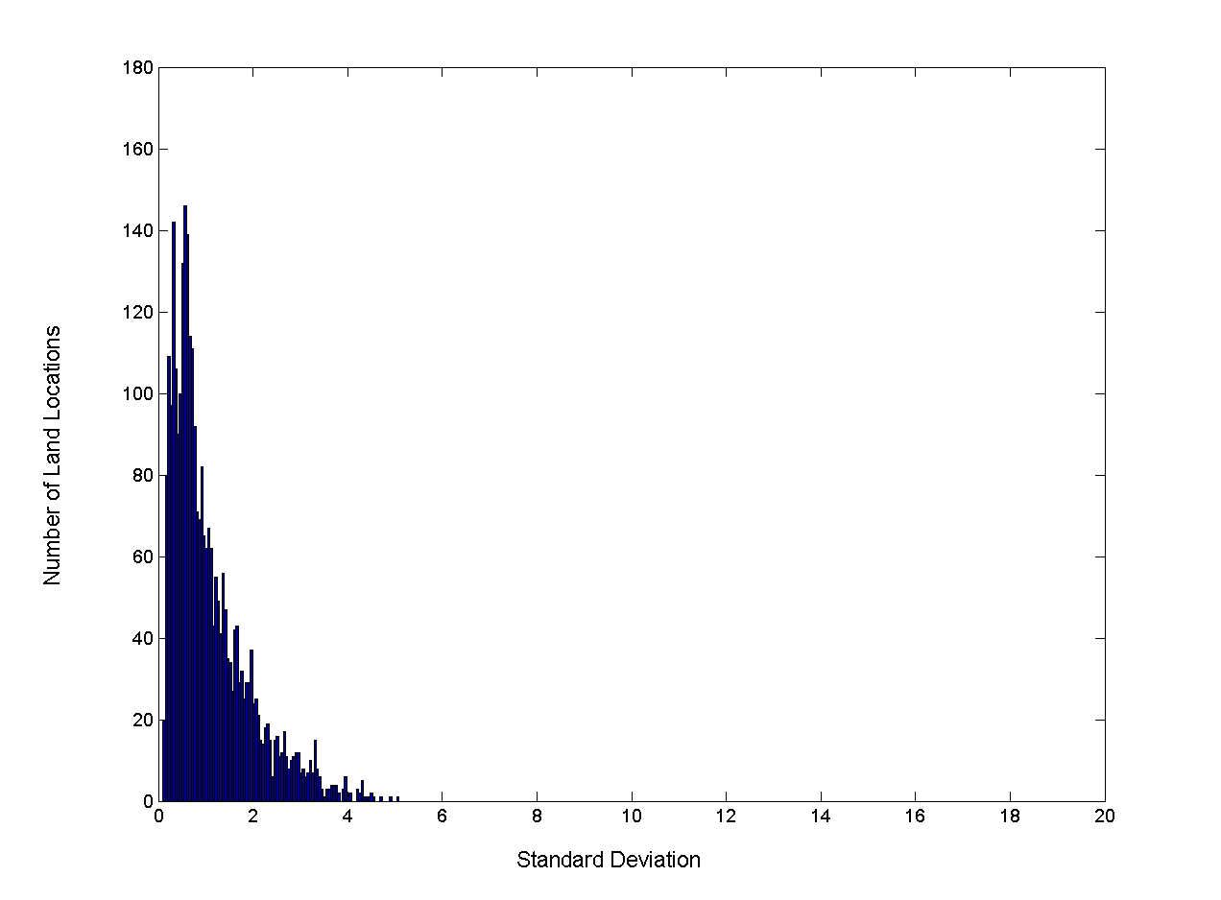
Aggregation
Variation of Precipitation in Australia
Standard Deviation of Average Monthly Precipitation
Standard Deviation of Average Yearly Precipitation

Slide 34
Sampling
Sampling is the main technique employed for data selection.
It is often used for both the preliminary investigation of the data and the final data analysis.
Statisticians sample because obtaining the entire set of data of interest is too expensive or time consuming.
Sampling is used in data mining because processing the entire set of data of interest is too expensive or time consuming.

Slide 35
Sampling …
The key principle for effective sampling is the following:
using a sample will work almost as well as using the entire data sets, if the sample is representative
A sample is representative if it has approximately the same property (of interest) as the original set of data

Slide 36
Types of Sampling
Simple Random Sampling
There is an equal probability of selecting any particular item
two variations on random sampling (other methods are also there)
Sampling without replacement
As each item is selected, it is removed from the population
E.g {1,5,9} then 1/3,5/2,9/1, each time population reduced
Sample object only picked once, item are dependent of each other.
Sampling with replacement
Objects are not removed from the population as they are selected for the sample.
In sampling with replacement, the same object can be picked up more than once
E.g {1,5,9} then 1/3,5/3,9/3. items will be independent of each other
Stratified sampling
Split the data into several partitions; then draw random samples from each partition
Quantity drawn will be same from each partition or
If partition are different in size then random samples are taken according to the proportion of the particular partition size.

Slide 37
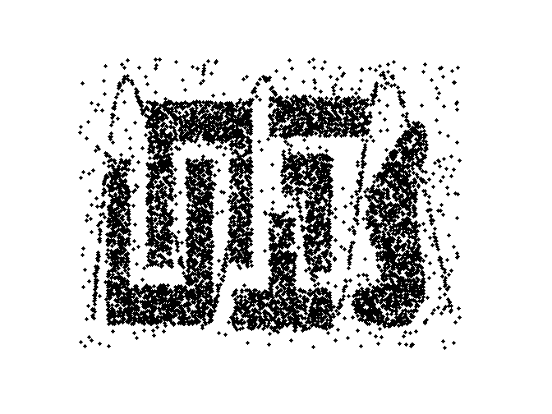
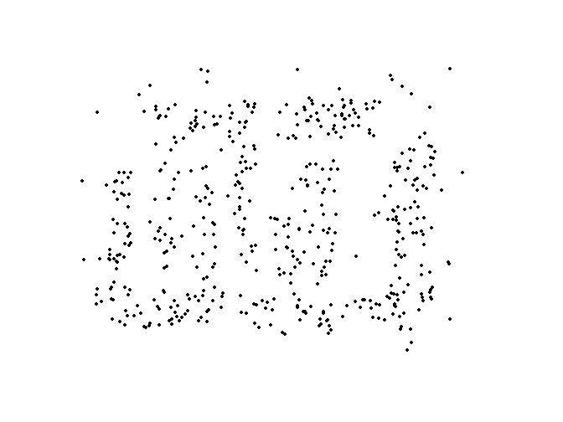
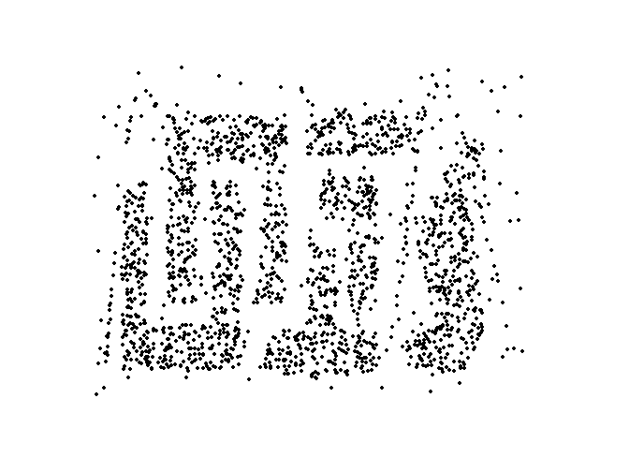
Sample Size and loss of information
Larger sample sizes increase the probability that a sample will be representative, but they also eliminate much of the advantage of sampling.
Conversely, with smaller sample sizes, patterns may be missed or erroneous patterns can be detected.
8000 points 2000 Points 500 Points

Slide 38
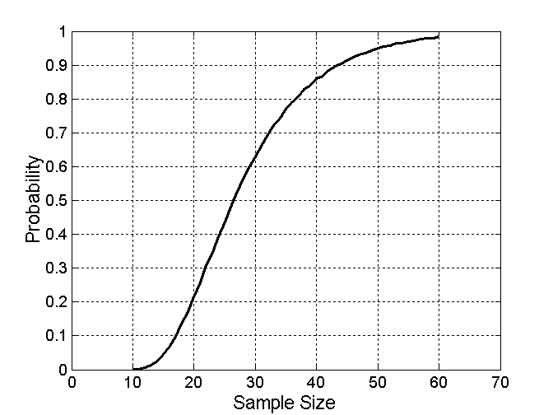
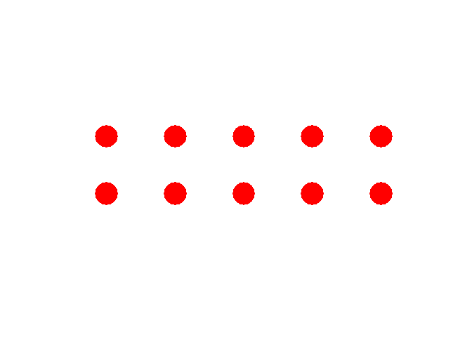
Sample Size
What sample size is necessary to get at least one object from each of 10 groups.
Its difficult to get proper sample size so we used adoptive (or progressive) sampling
These approaches start with a small sample, and then increase the sample size until a sample of sufficient size has been obtained.

Slide 39
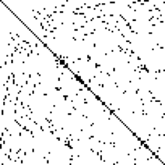
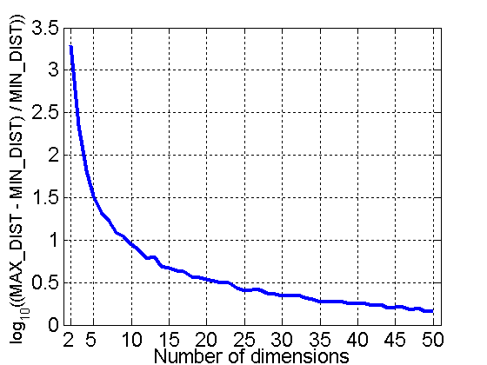
Curse of Dimensionality
Frequency for each word in a set of documents may have thousands of dimensions in a table.
When dimensionality increases, data becomes increasingly sparse in the space that it occupies
Definitions of density/similarity and distance/difference between points, which is critical for clustering and outlier detection, become less meaningful.
Randomly generate 500 points
Compute difference between max and min distance between any pair of points

Slide 40
Dimensionality Reduction
Purpose:
Avoid curse of dimensionality
Reduce amount of time and memory required by data mining algorithms
Allow data to be more easily visualized
May help to eliminate irrelevant features or reduce noise
Techniques to reduce dimensionality
Principal Component Analysis(PCA)
Singular Value Decomposition(SVD)
Others: supervised and non-linear techniques

Slide 41
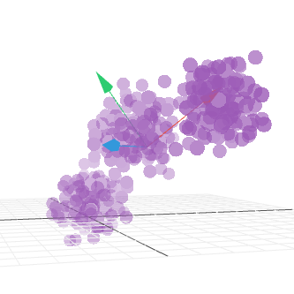
Dimensionality Reduction: PCA
Goal is to find a projection that captures the largest amount of variation in data
2D and 3D data projection.
x₂
e
x₁

Slide 42
Dimensionality Reduction: PCA
Find the eigenvectors of the covariance matrix
The eigenvectors define the new space
http://setosa.io/ev/principal-component-analysis/
x₂
e
x₁

Slide 43
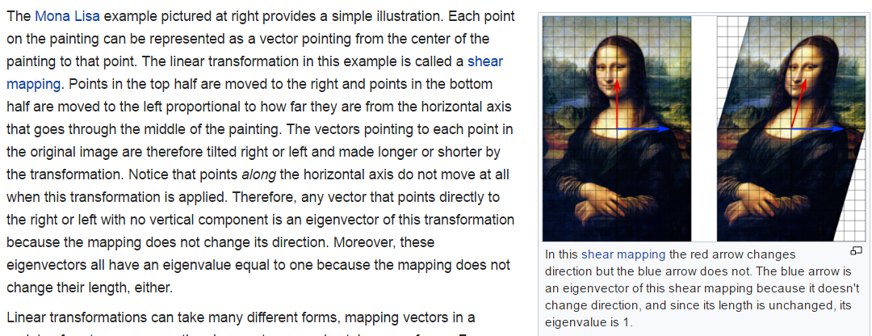
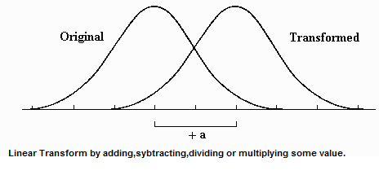
eigenvectors

Slide 44
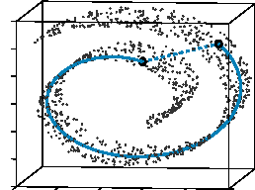
Dimensionality Reduction: ISOMAP
By: Tenenbaum, de Silva, Langford (2000)
Construct a neighbourhood graph
For each pair of points in the graph, compute the shortest path distances – geodesic distances

Slide 45
Dimensionality Reduction: PCA

Slide 46
Feature Subset Selection
Another way to reduce dimensionality of data
Redundant and irrelevant features can reduce classification accuracy and the quality of the clusters that are found.
Redundant features/attributes
duplicate much or all of the information contained in one or more other attributes
Example: purchase price of a product and the amount of sales tax paid
Irrelevant features/attributes
contain no information that is useful for the data mining task at hand
Example: students' ID is often irrelevant to the task of predicting students' GPA

Slide 47
Feature Subset Selection
Techniques:
Brute-force approach:
Try all possible feature subsets as input to data mining algorithm
Embedded approaches:
Feature selection occurs naturally as part of the data mining algorithm. The algorithm itself decides which attributes to use and which to ignore.
Filter approaches:
Features are selected before data mining algorithm is run. For example, we might select sets of attributes whose pairwise correlation is as low as possible.
Wrapper approaches:
Use the data mining algorithm as a black box to find best subset of attributes.
In the wrapper approach the attribute selection method uses the result of the data mining algorithm to determine how good a given attribute subset is.

Slide 48
Feature Creation
Create new attributes that can capture the important information in a data set much more efficiently than the original attributes.
Three general methodologies:
Feature Extraction
The creation of a new set of features from the original raw data
the presence or absence of certain types of edges and areas that are highly correlated with the presence of human faces can be applied on a set of human pictures for clustering.
domain-specific
Mapping Data to New Space: FT, WT
Feature Construction
combining features like use density instead of mass/volume.

Slide 49
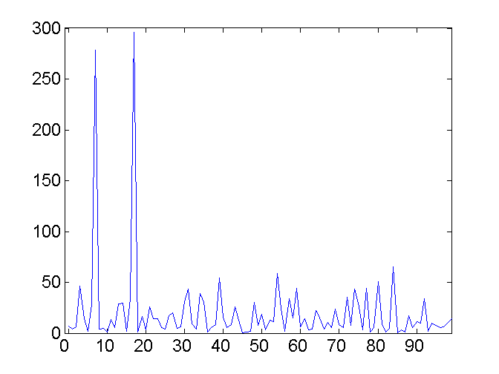
Mapping Data to a New Space
Fourier transform
Wavelet transform
Frequency
Two Sine Waves
Two Sine Waves + Noise

Slide 50
Discretization and Binarization
Some data mining algorithms(like classification) needs attributes in categorical form.
Algorithm that can find association rules needs attributes in binary from
So continuous attribute needs to be transformed into categorical attribute called discretization
While attributes transformed into binary form called binarization.

Slide 51
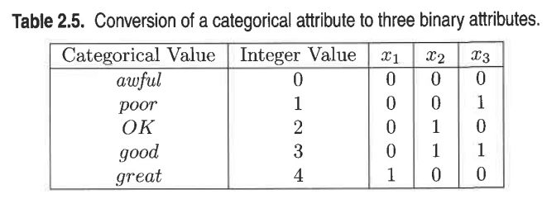
Binarization (Symmetric)
Simple binarization technique
if m categorical attributes then use integer [0,m-1]
If attribute is ordinal maintain order in assignment
But one complication: x₂ and x₃ have unintended relationship for OK and good. Not suitable for association analysis.

Slide 52
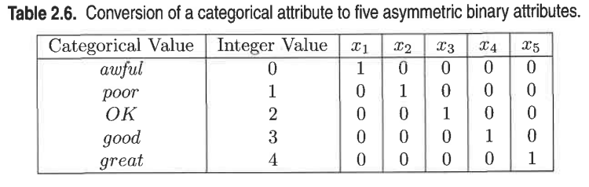
Binarization(Asymmetric)
Association analysis requires asymmetric binary attributes.
Likewise, for association problems, it may be necessary to replace a single binary attribute with two asymmetric binary attributes.
Like male and female have on in two attributes, but it inefficient way of binarization to use two bits to store for one attribute.

Slide 53
Discretization of Continuous Attributes
Discretization is typically applied to attributes that are used in classification or association analysis.
In general, the best discretization depends on the algorithm being used.
the discretization of an attribute is considered in isolation.
Transformation of a continuous attribute to a categorical attribute involves two subtasks:
deciding how many categories to have and determining
how to map the values of the continuous attribute to these categories
Age can be discretized as child(0-12), Teen(13-20), young(21-30), middle-age(31-45), old(>45) etc.

Slide 54
Discretization types
A basic distinction between discretization methods for classification is
whether class information is used (supervised) or
not used (unsupervised).
Unsupervised: If class information is not used, then relatively simple approaches are common.
Equal width
Divides the range of the attribute into a user-specified number of intervals each having the same width. It badly affects outliers. Due to this reason we can use
Equal frequency(equal Depth) (Histograms)
which tries to put the same number of objects into each interval, is often preferred.
Other approaches are
a clustering method K-means can be used
Visually inspection of data can be an effective approach
Unsupervised discretization methods are better than no discretization.

Slide 55
Simple Discretization: Binning
Equal-width (distance) partitioning
Divides the range into N intervals of equal size: uniform grid
if A and B are the lowest and highest values of the attribute, the width of intervals will be: W = (B –A)/N.
The most straightforward, but outliers may dominate presentation
Skewed data is not handled well
Equal-depth (frequency) partitioning
Divides the range into N intervals, each containing approximately same number of samples
Good data scaling
Managing categorical attributes can be tricky

Slide 56
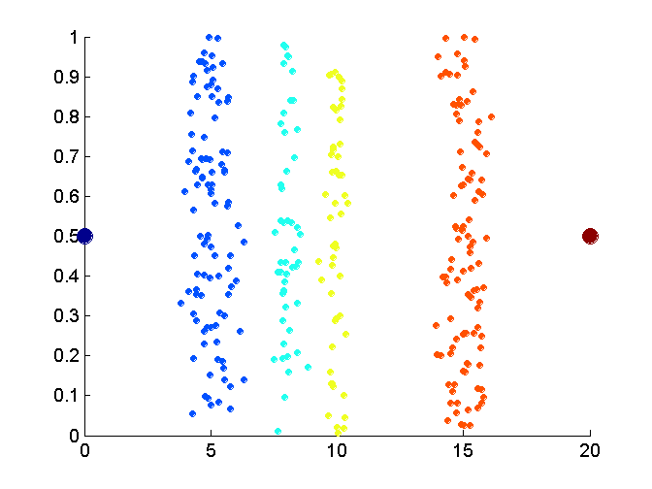
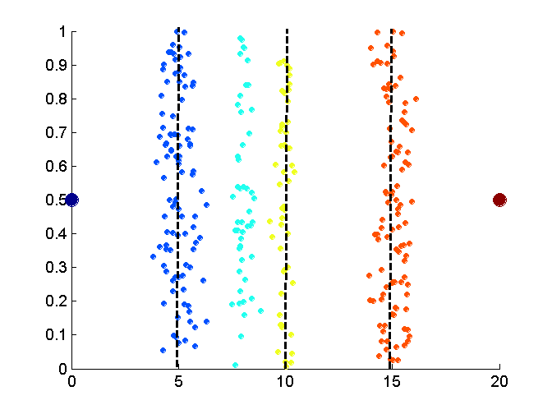
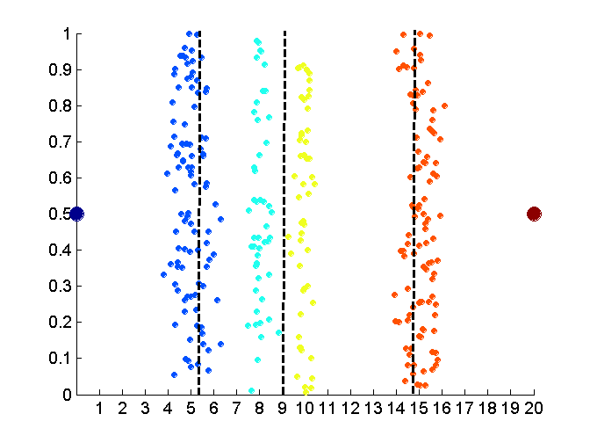
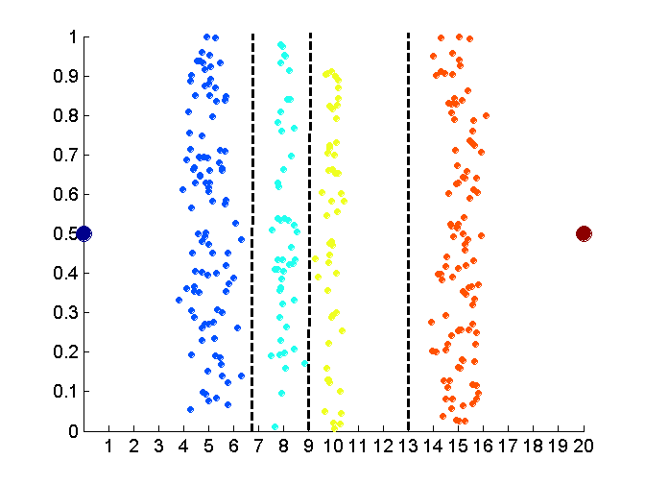
Discretization Without Using Class Labels
Unsupervised Discretization
Original Data
Equal interval width
Equal frequency
K-means

Slide 57
Supervised (using class label) discretization
an interval constructed with no knowledge of class labels often contains a mixture of class labels.
A conceptually simple approach is to place the splits in a way that maximizes the purity of the intervals.
In practice, how ever, such an approach requires potentially arbitrary decisions about the purity of an interval and the minimum size of an interval.
To avoid this concern an the statistical method ENTROPY is used
See the given Pdf file
A Simple Guide to Binning Data Using an Entropy Measure.pdf
Use excel solve the example

Slide 58
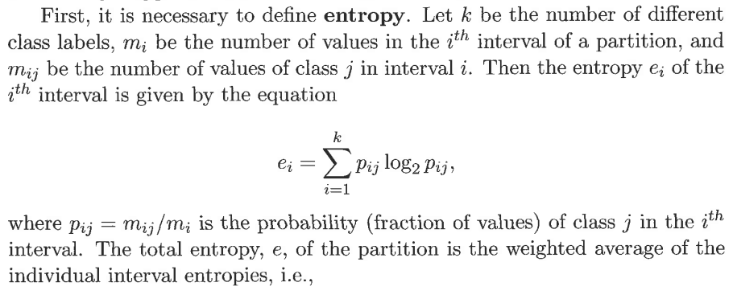
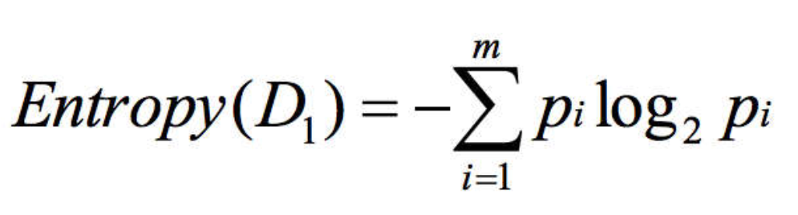
Entropy

Slide 59
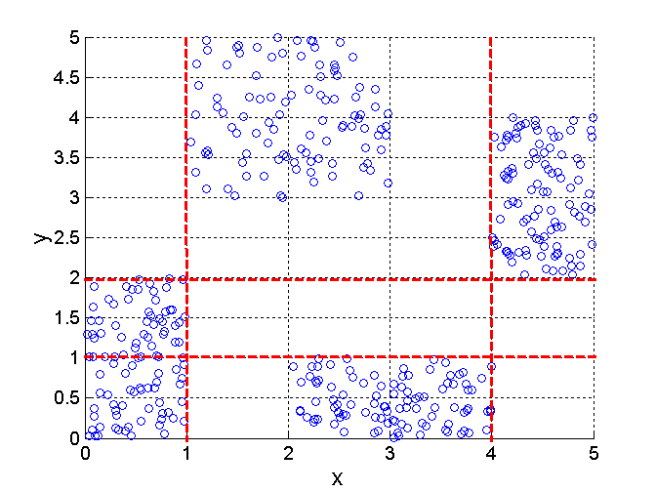
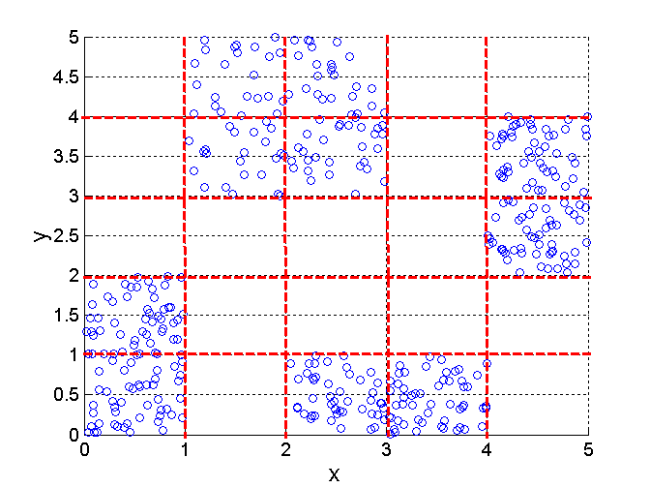
Discretization Using Class Labels
Entropy based approach
3 and 5 categories of two attributes x, y.
In general, discretizing each attribute separately often guarantees suboptimal results. Second, five intervals work better than three, but six intervals do not improve the discretization much, at least in terms of entropy.
3 categories for both x and y
5 categories for both x and y

Slide 60
Categorical Attributes with Too Many Values
Categorical attributes can sometimes have too many values then
If ordinal used previously discussed methods like supervised or unsupervised discretization
If nominal then use back ground knowledge to make meaningful groups.
Example: In an university Engineering department, Business department, CS departments may have many programs but can be categories by their department names.

Slide 61
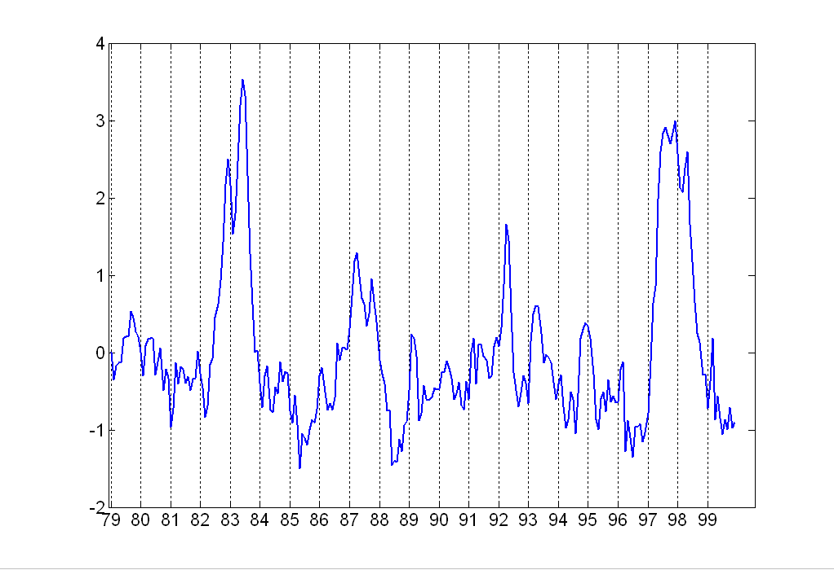
Attribute Transformation
A function that maps the entire set of values of a given attribute to a new set of replacement values(e.g by taking absolute value) such that each old value can be identified with one of the new values.
Simple functions: x^{k}, log(x), e^{x}, |x|,1/x, SQRT(x)
Standardization and Normalization
Its normally used when data have no normal (Gaussian) distribution.
For details see the normal distribution document

Slide 62
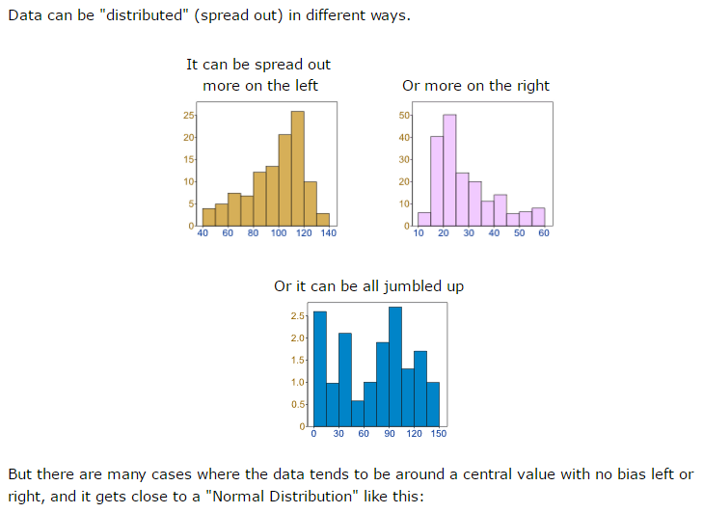
Normal Distribution

Slide 63
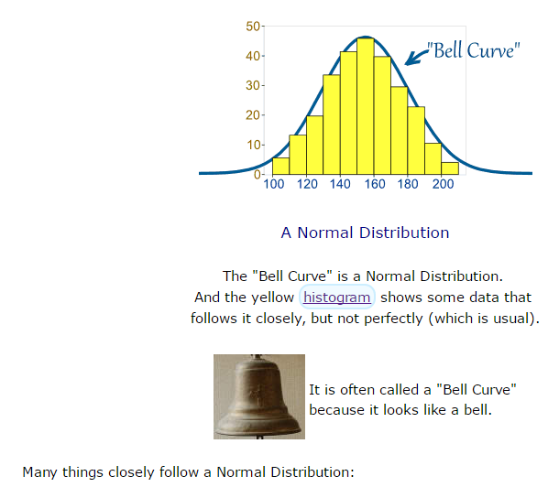
Normal Distribution

Slide 64
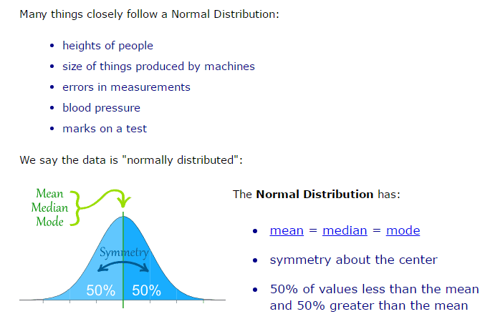
Normal Distribution

Slide 65
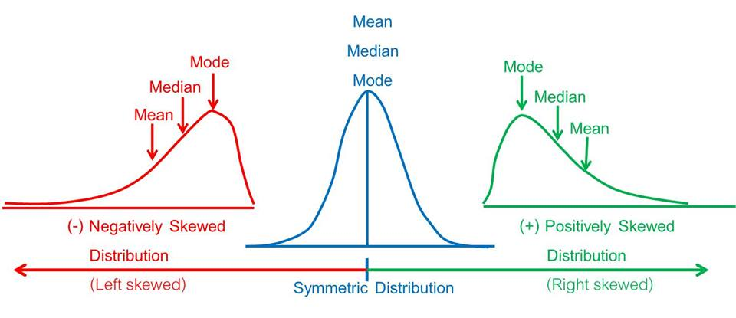
Normal Distribution

Slide 66
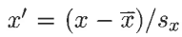
Normal Distribution
The goal of standardization or normalization is to make an entire set of values have a particular property.
A traditional example is that of "standardizing a variable" in statistics.
If X^ is the mean (average)of the attribute values and S_{x}, is their standard deviation, then the transformation x' = (x –X^)/S_{x} , creates a new variable that has a mean of 0 and a standard deviation of 1.

Slide 67
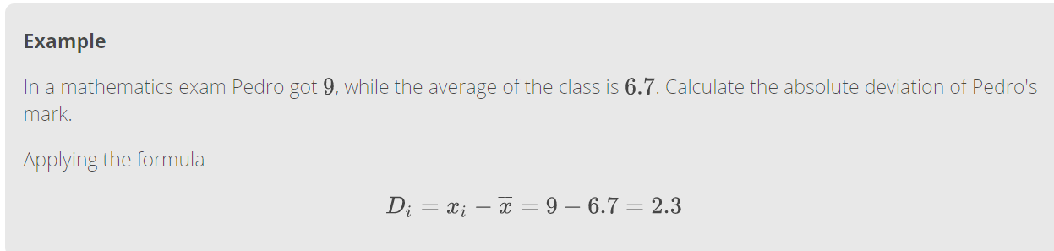
Normal Distribution
The mean and standard deviation are strongly affected by outliers so that we can use
Median(middle value) instead of mean
Absolute Standard deviation

Slide 68
Exercise on SPSS
Search for Data generator tool on google.
Create 1000 objects
By using following attributes
City, (Any six cities)
Disease (Any six)
People Effected (Range from 0 to 500)
By using SPSS
Perform statistical analysis like man median mode, variation n etc
Create different types of histograms, boxplot n etc
Show results in any document for in ppt form.

Slide 69
Similarity and Dissimilarity
Similarity and dissimilarity are important because they are used by a number of data mining techniques, such as
clustering, nearest neighbor classification, and anomaly detection.
For convenience, the term proximity is used to refer to either similarity or dissimilarity.
How to measure proximity having objects with
simple single attribute
multiple attributes
For two dimensional point and time series data
We use measures such as correlation and Euclidean distance.
For parse data like text documents we use
Jaccard and cosine similarity measure

Slide 70
Similarity and Dissimilarity
Similarity
Numerical measure of how alike two data objects are.
Is higher when objects are more alike.
Nonnegative, often falls in the range [0,1],
0=no, 1=high similarity
Dissimilarity
Numerical measure of how different are two data objects
Lower when objects are more alike
Minimum dissimilarity is often (0 to ∞), some time lies from [0,1]
Upper limit varies

Slide 71
Transformations by proximity
Transformations are often applied to convert a similarity to a dissimilarity, or vice versa, or
To transform a proximity measure to fall within a particular range, such as [0,1].
If some algorithm only computes similarity and we have dissimilarity, then we need transformation.
Or algorithm may work between range [0-1]

Slide 72
Transformations by proximity…
S | S'
100 | 0.0
200 | 0.1
300 | 0.2
400 | 0.3
500 | 0.4
600 | 0.6
700 | 0.7
800 | 0.8
900 | 0.9
1000 | 1.0
For example, if the similarities between objects range from 1 (not at all similar) to 10 (completely similar),
we can make them fall within the range [0,1] by using the transformation
s' = (s – min_s)/(max_s – min_s),
d' = (d – min_d)/(max_d – min_d)
Above proximity is within finite range[0-1].
S | S'
100 | 0
150 | 0.13
230 | 0.33
260 | 0.4
290 | 0.48
330 | 0.58
380 | 0.7
400 | 0.75
450 | 0.88
500 | 1

Slide 73
Transformations by proximity…
For interval [0,∞], then a non-linear transformation is needed and values will not have the same relationship to one another on the new scale.
Consider the transformation d' =d/(1 + d) for a dissimilarity measure that ranges from 0 to ∞.
The dissimilarities 0, 0.5, 2, 10, 100, and 1000 will be transformed into the new dissimilarities 0, 0.33, 0.67, 0.90, 0.99, and 0.999, respectively.
Correlation is measure of similarity that takes values in interval [1,-1], by taking the absolute value loses information about the sign, which can be important in some applications.
See the book for further details.

Slide 74
Similarity and Dissimilarity for Simple Attributes
The proximity of objects with a number of attributes is typically defined by combining the proximities of individual attributes
and thus, we first discuss proximity between objects having a single attribute. See table on next slide
If single attribute is nominal (Name or ID) then:
A nominal attribute contribute only distinctness, either two objects match or not.
For one nominal attribute when two objects are
Similar means 1 otherwise 0
Dissimilar means 1 otherwise 0

Slide 75
Similarity and Dissimilarity for Simple Attributes
For objects with a single ordinal attribute (See on next slide)
Consider an attribute that measures the quality of product (P1, P2) e.g a candy bar on scale {poor, fair, OK, good, wonderful} attribute, then
information about order should be taken into account
So ordinal attributes are mapped into successive integer values like {poor=0, fair=1, OK=2, good=3, wonderful=4}
P1 is good and P2 is OK
Then d(P1,P2) =3-2=1 or
If we want dissimilarity fall in [0,1] then
d(P1,P2) = (3-2)/4=0.25
similarity will be s=1-d=1-0.25=0.75
The difference between good and fair is not same as in poor and fair
Our option is limited and due to absence of more information its an standard method for defining proximity between ordinal attributes
For interval or ratio attributes, the natural measure of dissimilarity between two objects is the absolute difference of their values

Slide 76
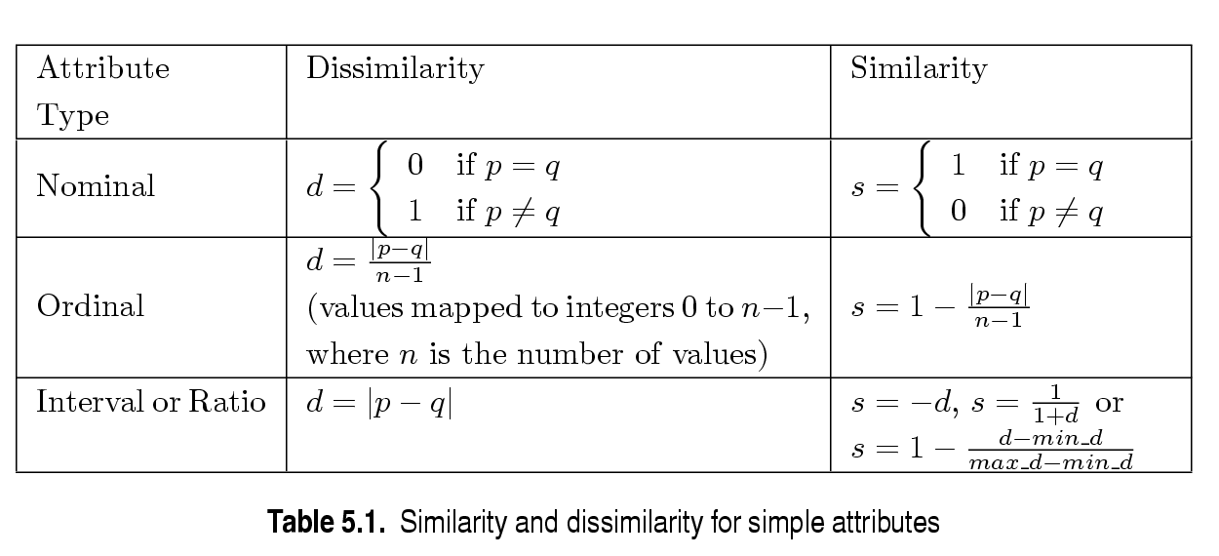
Similarity and Dissimilarity for Simple Attributes
p and q are the attribute values for two data objects.

Slide 77
Dissimilarities between Data Objects
Now we discuss various kinds of dissimilarities.
First we discuss distances
which are dissimilarities with certain properties
The Euclidean distance, d, between two points, x and y, in one-, two-, three-, or higher dimensional space.
NOTE
Dimension: An attribute or several attributes that together describe a property. For example, a geographical dimension might consist of three attributes: country, state, city. A time dimension might include 5 attributes: year, month, day, hour, minute.

Slide 78
Euclidean Distance
Euclidean Distance
Where n is the number of dimensions and p_{k} and q_{k} are, respectively,
the kth attributes (components) or data objects p and q.

Slide 79
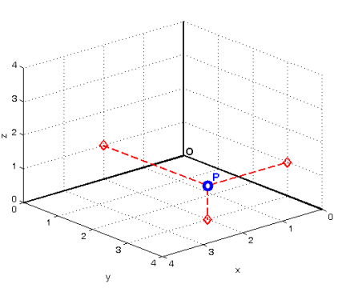
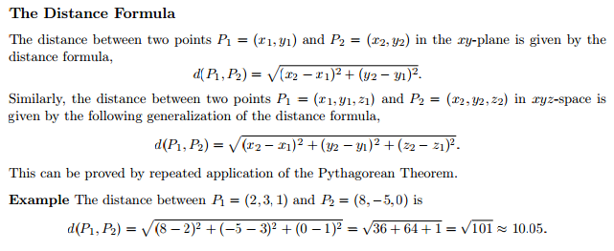

Slide 80
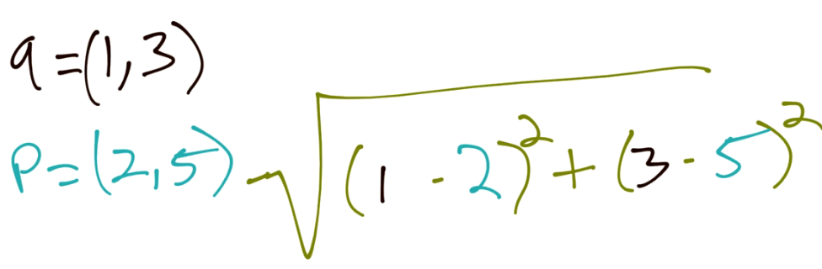
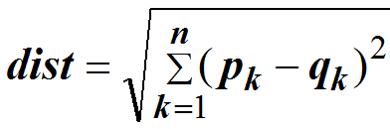
Euclidean Distance
P1(0,2)
P2(2,0)
(0-2)+(2-0)=(-2)+2=4+4=8=sqrt(8)=2.828
Distance Matrix
P(x,y) = 2 dimension
P(x,y,z) = 3 dimension
All elements on the diagonal of A are zero (i.e. it is a hollow matrix).

Slide 81
Minkowski Distance
Minkowski Distance is a generalization of both Euclidean Distance and Manhattan distance,
Where r is a parameter, n is the number of dimensions (attributes) and p_{k} and q_{k} are, respectively, the kth attributes (components) or data objects p and q.

Slide 82
Minkowski Distance: Examples
r = 1. City block (Manhattan, taxicab, L₁ norm) distance.
A common example of this is the Hamming distance, which is just the number of bits that are different between two binary vectors
r = 2. Euclidean distance
r → ∞. “supremum” (L_{max} norm, L∞ norm) distance. Or Chebyshev distance
This is the maximum difference between any component of the vectors
Do not confuse r with n, i.e., all these distances are defined for all numbers of dimensions.

Slide 83
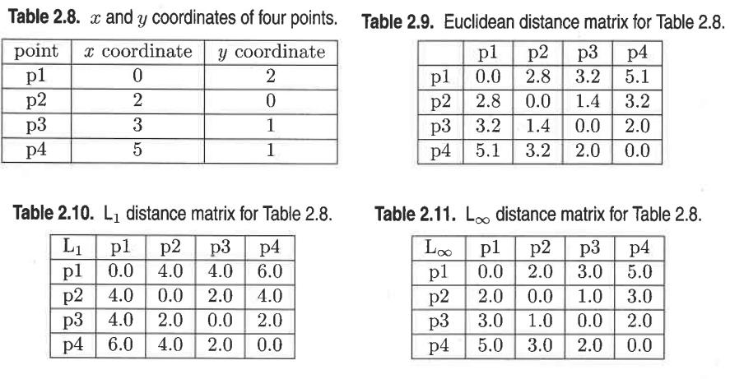
Minkowski Distance
L1= Manhattan or city block, L1 norm distance
L2= Euclidean Distance, L2 norm
L= ∞ norm , Lmax distance

Slide 84
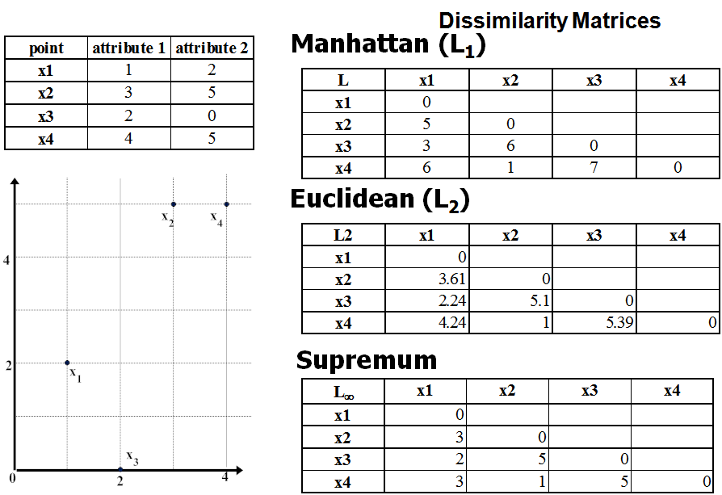

Slide 85
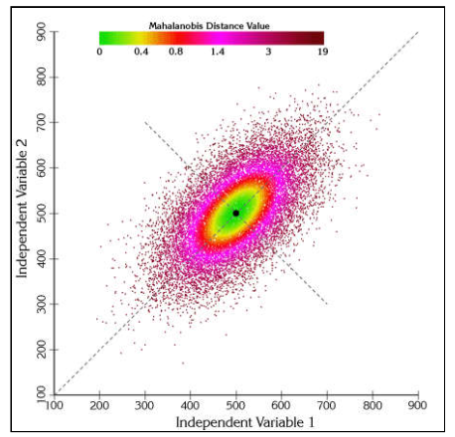
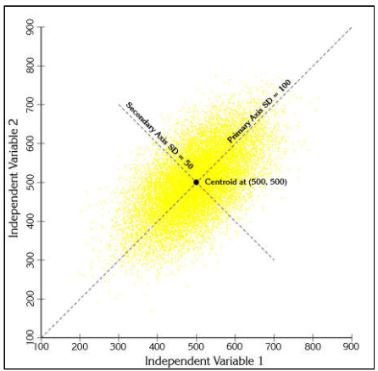
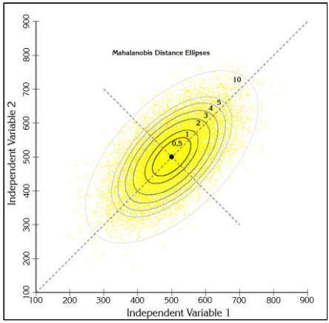
Mahalanobis Distance
The idea of measuring how many standard deviations away P is from the mean of D distribution.
Mahalanobis distance, is useful when attributes are correlated, have different ranges of values (different variances),and the distribution of the data is approximately Gaussian (normal).
So it will not work for two attributes like income and gender, where income is continuous and gender F or M.
Then use any standardization method like range for income.

Slide 86
Mahalanobis Distance
Consider the problem of estimating the probability that a test point in N-dimensional Euclidean space belongs to a set, where we are given sample points that definitely belong to that set. Our first step would be to find the average or center of mass of the sample points. Intuitively, the closer the point in question is to this center of mass, the more likely it is to belong to the set.
However, we also need to know if the set is spread out over a large range or a small range, so that we can decide whether a given distance from the center is noteworthy or not. The simplistic approach is to estimate the standard deviation of the distances of the sample points from the center of mass. If the distance between the test point and the center of mass is less than one standard deviation, then we might conclude that it is highly probable that the test point belongs to the set. The further away it is, the more likely that the test point should not be classified as belonging to the set.

Slide 87
Mahalanobis Distance
The drawback of the above approach was that we assumed that the sample points are distributed about the center of mass in a spherical manner.
Where the distribution is to be decidedly non-spherical, for instance ellipsoidal, then we would expect the probability of the test point belonging to the set to depend not only on the distance from the center of mass, but also on the direction.
In those directions where the ellipsoid has a short axis the test point must be closer, while in those where the axis is long the test point can be further away from the center.
Putting this on a mathematical basis, the ellipsoid that best represents the set's probability distribution can be estimated by building the covariance matrix of the samples.
The Mahalanobis distance is simply the distance of the test point from the center of mass divided by the width of the ellipsoid in the direction of the test point.

Slide 88
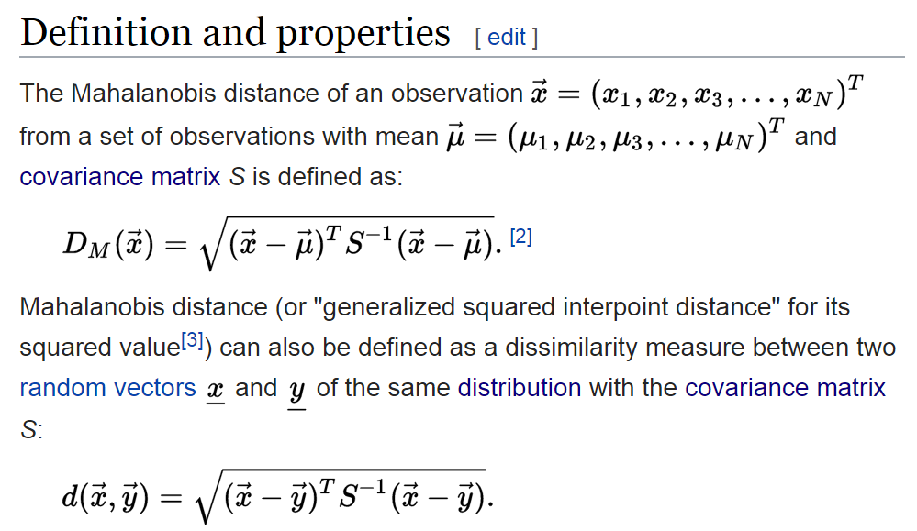
Mahalanobis Distance

Slide 89
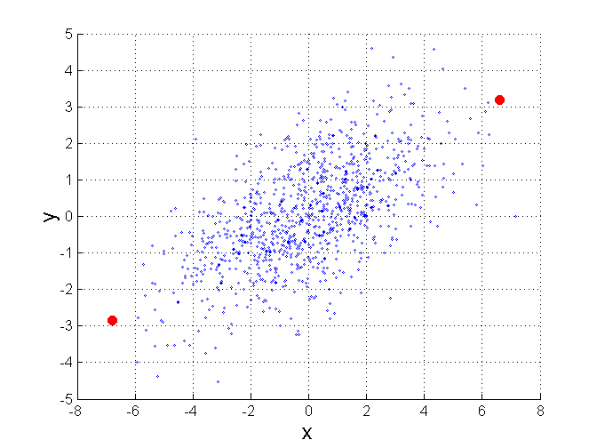
Mahalanobis Distance
C is the covariance matrix of the input data X
For red points, the Euclidean distance is 14.7, Mahalanobis distance is 6.

Slide 90
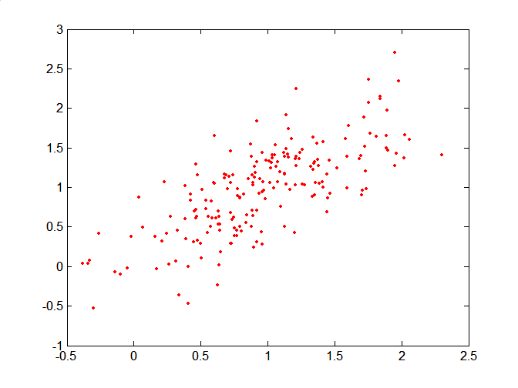
Mahalanobis Distance
Covariance Matrix:
P
B
A: (0.5, 0.5)
B: (0, 1)
P: (1.5, 1.5)
Mahal(A,B) = 5
Mahal(A,P) = 4
A

Slide 91
Common Properties of a Distance
Distances, such as the Euclidean distance, have some well known properties. Positivity,Symmetry and triangular inequality.
d(p, q) ≥ 0 for all p and q and d(p, q) = 0 only if p = q. (Positive definiteness)
d(p, q) = d(q, p) for all p and q. (Symmetry)
d(p, r) ≤ d(p, q) + d(q, r) for all points p, q, and r. (Triangle Inequality)
where d(p, q) is the distance (dissimilarity) between points (data objects), p and q.
A distance that satisfies these ( Positivity, Symmetry and triangular inequality) properties is a metrics.
Many dissimilarities do not satisfy one or more of the metric properties. Like Time and Set differences

Slide 92
SETS NOT HOLD METRIC PROPERTIES
A={1,2,3,4}
B={2,3,4}
A-B={1}
B-A= ∅
While dissimilarity or distance can not be ∅.
It will be >=0
So it can be modified as
d(A,B) = size(A-B)+size(B-A) = 1+0=1

Slide 93
Time not hold metric property
d(1pm,2pm)= 1 hour
d(2pm,1pm) = 23 hours
If an event occurs at 2 pm then one have to wait for 23 hours to occur again.

Slide 94
Similarities between Data Objects

Slide 95
Similarities between Data Objects
For similarities, the triangle inequality typically does not hold, but symmetry and positivity typically do:
If s(x, y) is the similarity between points x and y, then the typical properties of similarities are the following
s(x,y) = 1 (or maximum similarity) only if x = y. (0 < s ≤ 1)
s(x,y) = s(y, x) for all x and y. (Symmetry)
But similarity some times can be converted into metric distance by
Cosine and Jaccard similarity measure

Slide 96
Example 2.L6 (A Non-symmetric Similarity Measure).
Consider an experiment in which people are asked to classify a small set of characters as they flash on a screen.
The confusion matrix for this experiment record show often each character is classified as itself and how often each is classified as another character
If we take these counts as a measure of the similarity between two characters, then we have a similarity measure, but one that is not symmetric. So can calculate:
 | Zero - 0 | O
Zero - 0 | 160 | 40
O | 30 | 170

Slide 97
Example 2.L6 (A Non-symmetric Similarity Measure).
S(“0”, “o”) =40/200*100 = 20%
s(“o”, “0”) = 30/200*100 = 15%
In such situations, the similarity measure is often made symmetric by setting
s’(x,y) = s’(y,x) = (s(x,y)+ (s(y,x))/2
s’(“0”, “o”)= s’(“o”, “0”)= (20+15)/2 = 17.5%

Slide 98
Similarity Measures for Binary Data (Examples)
Similarity measures between objects that contain only binary attributes are called similarity coefficients, and typically have values between 0 and 1.
A value of 1 indicates that the two objects are completely similar,
while a value of 0 indicates that the objects are dissimilar.
Let x and y be two objects that consist of n binary attributes. The comparison of 2 such objects, i.e. two binary vectors, leads to the following four quantities (frequencies)
f00= the number of attributes where x is 0 and y is 0
f01= the number of attributes where x is 0 and y is 1
f10= the number of attributes where x is 1 and y is 0
f11= the number of attributes where x is 1and y is 1

Slide 99
Similarity measure
Simple Matching Coefficient (SMC)
Jaccard Coefficient
Cosine similarity
Corelation

Slide 100

Simple Matching Coefficient (SMC)
commonly used similarity coefficient is defined as:
This measure counts both presences and absences equally.

Slide 101

Jaccard Coefficient
In some situations, only the presence of an item is relevant,
supposed we want to do a basket market study, if we were to count all items that a person did not buy,
their number will outnumber the items purchased by far and it can compromise our study.
The Jaccard coefficient (J) is often used in this type of situation in which we have asymmetric binary attributes.

Slide 102

SMC versus Jaccard: Example
we calculate SMC and J for the following two binary vectors.
Since the number of products not purchased by any customer far outnumbers the number of products that were purchased,
a similarity measure such as SMC would say that all transactions are very similar.
As a result, the Jaccard coefficient is frequently used to handle objects consisting of asymmetric binary attributes.

Slide 103

Example #1 Jaccard Similarity

Slide 104

Example #1 Jaccard Similarity

Slide 105

Cosine Similarity (non-binary vector)
Its for non binary vector and ignores 0-0 matches like jaccard method
If d₁ and d₂ are two document vectors, then
cos( d₁, d₂ ) = (d₁ • d₂) / ||d₁|| ||d₂|| ,
where • indicates vector dot product and || d || is the length of vector d.
Example:
d₁ = 3 2 0 5 0 0 0 2 0 0
d₂ = 1 0 0 0 0 0 0 1 0 2
d₁ • d₂= 3*1 + 2*0 + 0*0 + 5*0 + 0*0 + 0*0 + 0*0 + 2*1 + 0*0 + 0*2 = 5
||d₁|| = (3*3+2*2+0*0+5*5+0*0+0*0+0*0+2*2+0*0+0*0)^{0.5} = (42) ^{0.5} = 6.481
||d₂|| = (1*1+0*0+0*0+0*0+0*0+0*0+0*0+1*1+0*0+2*2) ^{0.5} = (6) ^{0.5} = 2.245
cos( d₁, d₂ ) = .3150

Slide 106
Cosine Similarity
Documents are often represented as vectors, in which each attribute represents the frequency with which a particular term (word) occurs in the document.
Even though documents may have thousands or tens of thousands of words, each document is sparse since it has few non zero attributes.
Therefore, a similarity measure for documents needs to ignore 0-0 matches like Jaccard measure, but must handle non-binary vectors.
The cosine similarity is the most common measure of document similarity.

Slide 107

Cosine Similarity…
if x and y are 2 documents, then:

Slide 108


Cosine Similarity…
We can assume X = doc1 and y is doc2
Notes:
Cos inverse(.31) =72 degree

Slide 109

Cosine Similarity…
As indicated by Figure, cosine similarity really is a measure of the (cosine of the) angle between x and y.
Thus, if the cosine similarity is 1, the angle between x and y is 0⁰, and x and y are the same except for magnitude (length).
If the cosine similarity is 0, then the angle between x and y is 90⁰, and they do not share any terms (words).

Slide 110
Calculate Cosine similarity
Cos(d1,d2)
Cos(d1,d3)
Cos(d2,d3)

Slide 111

Extended Jaccard Coefficient (Tanimoto)
The extended Jaccard coefficient can be used for document data and that reduces to the Jaccard coefficient in the case of binary attributes.
The extended Jaccard coefficient is also known as the Tanimoto coefficient

Slide 112
Extended Jacard Coefficient
We can assume X = doc1 and y is doc2
EJ(x,y) = 0.119
Notes:
EJ=0.119

Slide 113

Correlation
Correlation measures the linear relationship between objects
To compute correlation, we standardize data objects, x and y, and then take their dot product

Slide 114

Correlation Formula

Slide 115

Correlation Degree

Slide 116

Visually Evaluating Correlation
Scatter plots showing the similarity from –1 to 1.

Slide 117

Linear/nonlinear, perfect, positive correlation
Perfect Correlation: Correlation is always in the range -1 to 1. A correlation of 1 (-1) means that x and y have a perfect positive (negative) linear relationship.
Non-linear Relationships: If the correlation is 0, then there is no linear relationship between the attributes of the two data objects. How ever, non-linear relation ships may still exist.

Slide 118


Slide 119

Solved example Pearson correlation

Slide 120

Find correlation

Slide 121
Issues in Proximity Calculation
How to handle the case in which attributes have different scales and/or are correlated,
when attributes do not have the same range of values.
How to calculate proximity between objects that are composed of different types of attributes, e.g., quantitative and qualitative,
How to handle proximity calculation when attributes have different weights;
i.e., when not all attributes contribute equally to the proximity of objects.

Slide 122
1-The variables have different scale
Earlier, Euclidean distance was used to measure the distance between people based on two attributes: age and income.
Unless these two attributes are standardized, the distance between two people will be dominated by income.
A related issue is how to compute distance when there is correlation between some of the attributes?
then we can use Mahalanobis distance

Slide 123


Using Weights to Combine Similarities
May not want to treat all attributes the same.
Use weights w_{k} which are between 0 and 1 and sum to 1.

Slide 124
Density
Density-based clustering require a notion of density
Examples:
Euclidean density
Euclidean density = number of points per unit volume
Probability density
Graph-based density

Slide 125

Euclidean Density – Cell-based
Simplest approach is to divide region into a number of rectangular cells of equal volume and define density as # of points the cell contains

Slide 126

Euclidean Density – Center-based
Euclidean density is the number of points within a specified radius of the point

